Slide 1
Data Governance Roles and Responsibilities
IS465: Data Management and Governance

Slide 2
Outline
Data governance roles in an organization
Data management roles and responsibilities
Data stewardship and data ownership

Slide 3
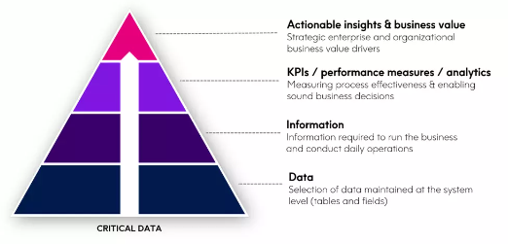
Business First Approach
Prioritize the data that matters
Link Data Governance Efforts to business goals
Iteratively pressure test model against valued added Use Cases
Build and sustain stakeholder engagement across all levels
Data Governance programs that prioritize critical data have 5x faster time-to-value

Slide 4
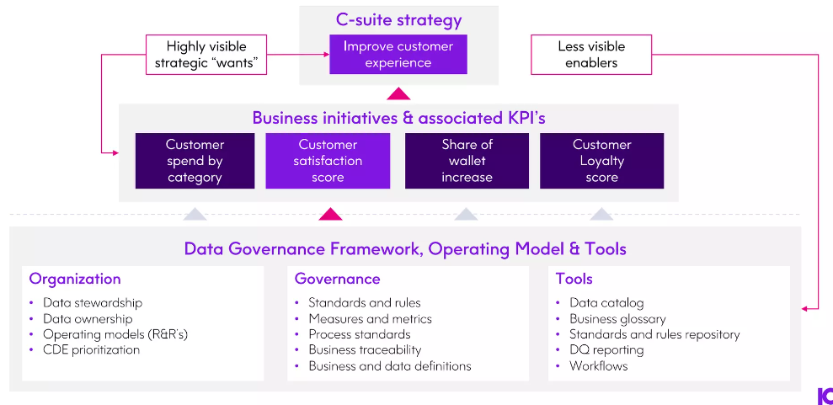
Linkage to Strategy Makes Governance Relevant

Slide 5
Data governance roles in an organization

Slide 6
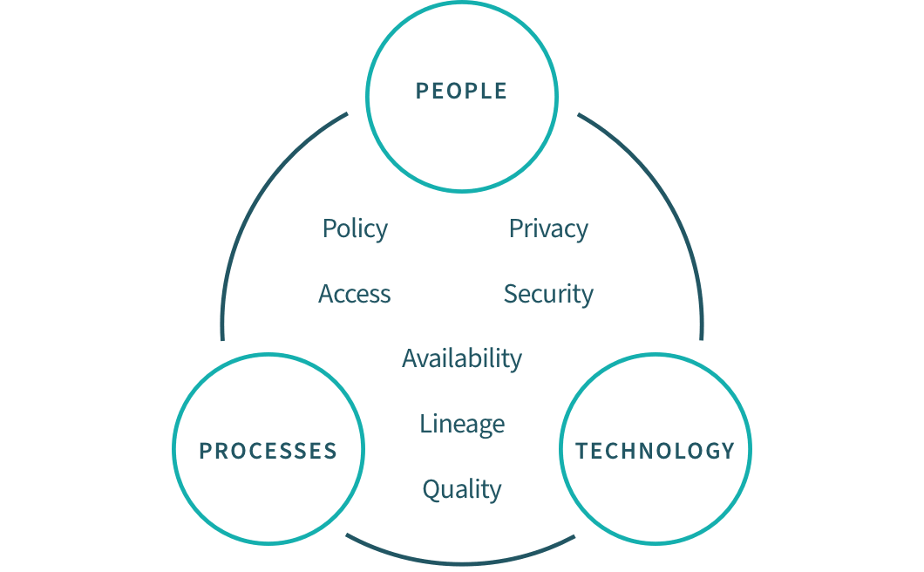
Data Governance Framework

Slide 7
Data Governance: Why It Matters
Data governance is the process of managing data quality, security, and access across an organization.
It ensures that data is accurate, complete, and accessible to the right people.
Data governance is critical for maintaining customer trust, regulatory compliance, and business success.

Slide 8
Why is it Important?
The primary benefit of data governance is providing the high-quality data necessary for data analytics and BI tools.
The insights gained from these tools result in better business decisions and improved performance.
Additional benefits include:
Improved data accuracy, completeness, and consistency
Prevention of data misuse
Agreement on common data definitions
Removal of data silos between departments and systems
Increased trust in data for analytics and decision making
Easier to locate data making all data more available
Better compliance with data privacy laws and other government regulations

Slide 9
Key Components of Data Governance
Data governance team
A cross-functional team responsible for overseeing data governance across the organization.
Data stewards
Individuals responsible for managing data within their departments or business units.
Data custodians
IT staff responsible for storing, securing, and maintaining data systems.
Data policies
Formal policies and procedures that govern data management and use.

Slide 10
Key Components of Data Governance
Data standards
Standardized formats and definitions for data elements and attributes.
Data catalogs
Centralized inventories of data assets and their metadata.
Data quality tools
Software tools used to monitor and improve data quality.

Slide 11
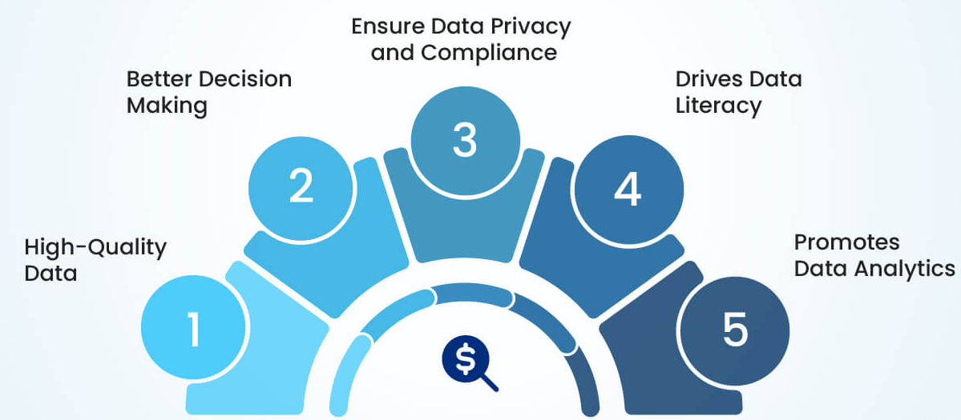
Benefits of Data Governance

Slide 12
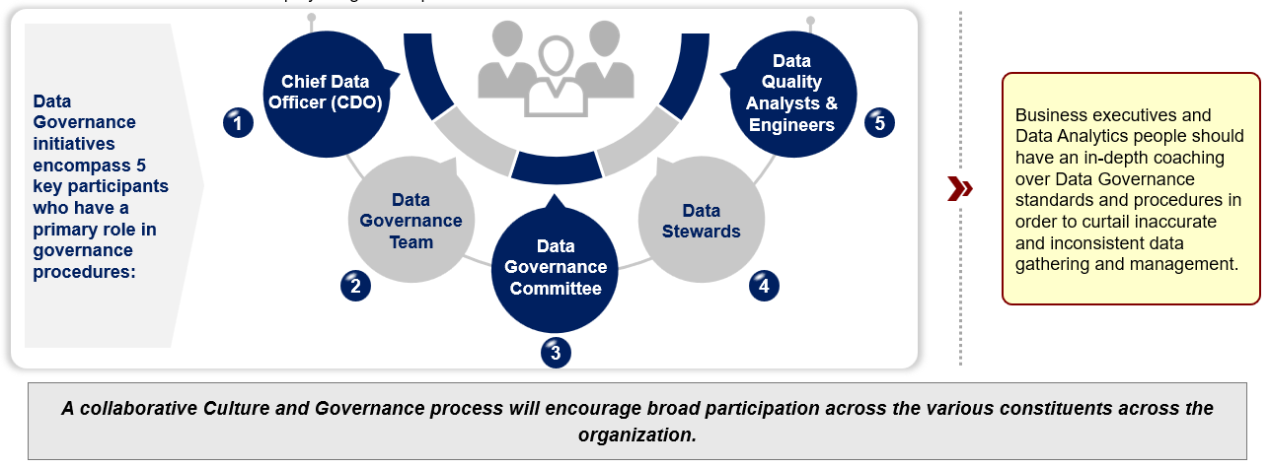
Data Governance Roles
Data governance roles are the different positions and responsibilities within an organization that are responsible for managing data.
These roles are critical for ensuring data quality, security, and compliance.

Slide 13
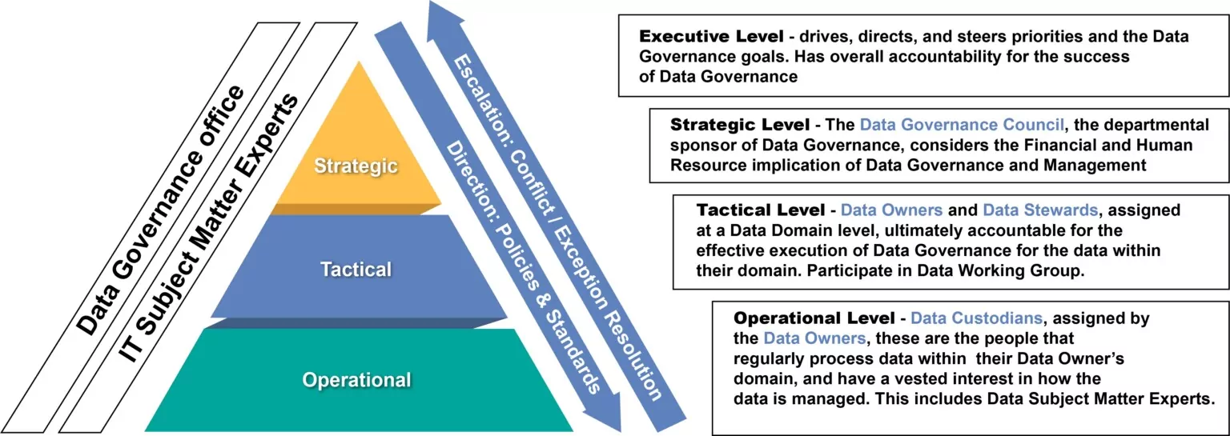
Stakeholder Levels

Slide 14
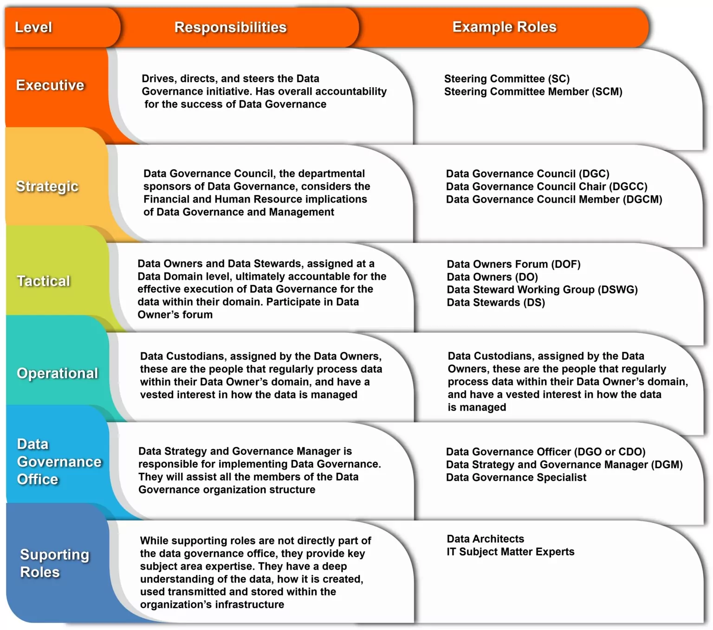
Establish Roles and Responsibilities

Slide 15
Data Governance Roles and Responsibilities
Data governance roles and responsibilities are the specific positions and tasks within an organization that are responsible for managing data.
Data Governance Team
Data Steward
Data Custodian
Data Analyst
Data Quality Analyst
Data Security Officer

Slide 16
Data Governance Team
The Data Governance Team is responsible for overseeing data governance across the organization.
The Data Governance Team is a cross-functional team that includes representatives from different departments and business units.
Responsible for developing and implementing data governance policies and procedures.
Ensures that data governance policies and procedures are communicated and enforced across the organization.
Monitors and reports on data governance compliance and makes recommendations for improvements.

Slide 17
Data Steward
Data Stewards are responsible for managing data within their department or business unit.
Data Stewards are individuals responsible for managing data within their department or business unit.
Responsible for ensuring that data is accurate, complete, and consistent.
Ensure that data is accessible to authorized personnel and that data security and privacy are maintained.
Work closely with the Data Governance Team to ensure that data governance policies and procedures are followed.

Slide 18
Data Custodian
IT staff responsible for storing, securing, and maintaining data systems.
Responsible for the technical management of data systems, including data storage, security, and maintenance.
Their role includes ensuring data systems are running smoothly, efficiently, and securely, and that data is properly backed up and recovered in case of system failures or other disruptions.
Work closely with the Data Governance Team to ensure that data systems are aligned with organizational data governance policies and procedures.
Ensures that data access controls are in place and that data is properly secured against unauthorized access or breaches.
Monitor data systems for potential security risks and work with the Data Security Officer to address any security concerns.

Slide 19
Data Analyst
An individual responsible for analyzing data and creating reports.
Responsible for analyzing data to support business decision-making, strategic planning, and operational optimization.
Their role includes creating reports, dashboards, and other visualizations to help stakeholders understand data trends and patterns.
Work closely with the Data Governance Team to ensure that data is accurate, complete, and consistent, and that data analysis is conducted in accordance with organizational data governance policies and procedures.
Works with data stewards to ensure that data is properly cataloged and inventoried, and that data quality is monitored and improved.

Slide 20
Data Quality Analyst
An individual responsible for monitoring and improving data quality.
Responsible for monitoring and improving data quality across the organization.
Their role includes identifying data quality issues, developing data quality metrics, and implementing data quality improvement plans.
Work closely with data stewards and data analysts to ensure that data is accurate, complete, and consistent, and that data quality issues are identified and addressed.
Works with the Data Governance Team to ensure that data quality policies and procedures are in place and followed across the organization.

Slide 21
Data Security Officer
An individual responsible for ensuring data security and compliance.
The Data Security Officer is responsible for ensuring that organizational data is properly secured and protected against unauthorized access, breaches, or other security threats.
Their role includes developing and implementing data security policies and procedures, conducting security audits and risk assessments, and ensuring compliance with relevant data security regulations and standards.
Work closely with the Data Governance Team to ensure that data security policies and procedures are aligned with organizational data governance policies and procedures.
Works with data custodians and data analysts to ensure that data systems are properly secured and that data access controls are in place.

Slide 22
Data management roles and responsibilities

Slide 23
An Overview
Data management roles and responsibilities are critical for ensuring data quality, security, and compliance.
Clearly defined roles and responsibilities help to avoid confusion and ensure that tasks are completed efficiently.

Slide 24
Data Management Roles
Enterprise Architect
Data Architect
Data Modelers
IT Managers
Data Engineers
Data Storage Managers
Big Data Analysts
Data Warehouse Architects
Data Warehouse Engineers
Data Warehouse Analysts
Business Intelligence Analysts
Master Data Managers
Data Governance Managers
Data Stewardship Managers
Data Quality Analysts
Data Operations Managers
Reference Data Managers
Data Integration Specialists
Data Interoperability Specialists
Enterprise Integration Architects
Data Scientists
Data Analysts
Business Analysts
Machine Learning Engineers
Predictive Modeling Analysts
Data Visualization Specialists
Data Monetization Strategists
Document Management Specialists
Content Management Specialists
Enterprise Content Management Architects
Information Architects

Slide 25
Different Data Management Roles
Data Architect
Database Administrator (DBA)
Data Analyst
Data Scientist
Data Manager
Data Modeler
Data Quality
Data Engineer

Slide 26
Data Architect
Responsible for designing and maintaining the overall data architecture of an organization, including data storage, processing, and retrieval systems.
Develops and implements data management strategies, policies, and standards to ensure data quality, security, and compliance with regulations.
Collaborates with data scientists, data analysts, and other stakeholders to ensure that data architecture meets business needs and supports data-driven decision-making.
Identifies and evaluates new technologies and techniques for data management and makes recommendations for their adoption.

Slide 27
Data Manager
Responsible for managing the day-to-day operations of an organization's data management function, including data management staff, budgets, and resources.
Collaborates with data architects to develop and implement data management strategies, policies, and standards.
Ensures that data management systems and processes are compliant with regulations and meet business needs.
Develops and implements data governance and quality control processes to ensure the accuracy, completeness, and consistency of data.

Slide 28
Database Administrator (DBA)
Responsible for the management, maintenance, and performance of an organization's databases, including database design, development, and optimization.
Ensures data security, privacy, and compliance with regulations, and troubleshoots database issues and errors.
Collaborates with data analysts and data scientists to ensure that database structures and configurations meet business needs.
Develops and implements database documentation, standards, and best practices.

Slide 29
Data Analyst
Responsible for collecting, organizing, and analyzing data to support business decision-making and strategy.
Develops and maintains databases, data warehouses, and other data storage systems to support data analysis and reporting.
Creates reports, visualizations, and dashboards to communicate data insights to stakeholders.
Collaborates with data scientists to develop predictive models and machine learning algorithms to solve business problems.

Slide 30
Data Scientist
Responsible for developing and applying machine learning models, statistical models, and other advanced analytics techniques to solve complex business problems.
Collaborates with data analysts and data engineers to design and implement data pipelines and ensure data quality.
Develops and maintains data visualizations and other tools to communicate insights and results to stakeholders.
Collaborates with data architects and data managers to ensure that data management strategies and systems support the needs of data science.

Slide 31
Data Modeler
Responsible for designing and maintaining data models to support data management and analysis.
Collaborates with data architects and data scientists to develop and implement data models that meet business needs and support data-driven decision-making.
Develops and maintains data dictionaries and other metadata to document and communicate data models and data relationships.
Ensures that data models are compliant with data management standards and best practices.

Slide 32
Data Quality
Responsible for ensuring the accuracy, completeness, and consistency of an organization's data.
Collaborates with data managers and data analysts to develop and implement data quality control processes and procedures.
Identifies and resolves data quality issues and defects, and develops and implements data quality metrics and reporting.
Ensures that data quality processes and procedures are compliant with regulations and meet business needs.

Slide 33
Data Engineer
Responsible for designing, building, and maintaining the infrastructure and tools needed to support data management and analysis.
Collaborates with data architects and data scientists to develop and implement data pipelines and ensure data quality.
Develops and maintains data processing and storage systems, including data warehouses, data lakes, and other data storage solutions.
Ensures that data engineering systems and processes are compliant with regulations and meet business needs.

Slide 34
Data stewardship and data ownership

Slide 35
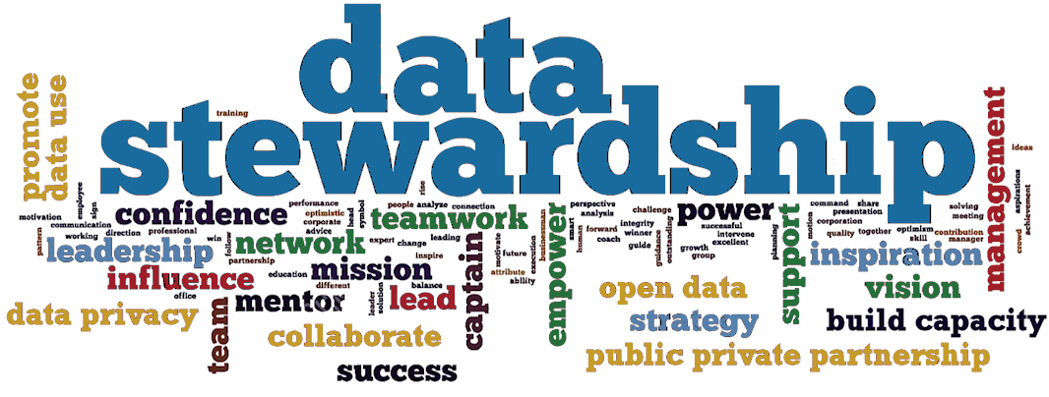
Data Stewardship
A Key Component of Data Governance
Data stewardship refers to the management and oversight of an organization's data assets to ensure their quality, security, and accessibility.
Importance of data stewardship in data governance:
Data stewardship is a critical component of data governance, as it ensures that data is properly managed and utilized across an organization.

Slide 36
Data Stewardship Roles and Responsibilities
Data stewardship roles:
Data owner: The person or group responsible for the accuracy, completeness, and integrity of the data.
Data custodian: The person or group responsible for the security, storage, and retrieval of the data.
Data user: The person or group that uses the data to perform their job functions.
Responsibilities:
Data quality: Ensuring the accuracy, completeness, and integrity of the data.
Data security: Protecting the data from unauthorized access, corruption, or loss.
Data accessibility: Ensuring that data is accessible to authorized users.
Data retention: Ensuring that data is properly stored and retained according to organizational policies and legal requirements.

Slide 37
Data Stewardship Best Practices
Data quality:
Validate data inputs
Use data validation rules
Perform data quality checks
Data security:
Implement access controls
Use encryption
Monitor data access and usage
Data accessibility:
Use data catalogs and inventories
Provide data access training
Implement data search and retrieval tools
Data retention:
Implement data retention policies
Use data archiving and backups
Monitor data storage and retrieval

Slide 38
Data Stewardship in the Digital Age
The digital age has brought about an explosion of data, making data stewardship more critical than ever.
Emerging technologies such as AI, machine learning, and the cloud have created new challenges and opportunities for data stewardship.
Data stewardship must evolve to keep pace with the changing technology landscape.

Slide 39
Data Stewardship Challenges
Data volume and complexity
The sheer volume and complexity of data can make it difficult to manage and govern.
Data silos
Data silos can lead to data duplication, inconsistencies, and security risks.
Data privacy and regulations
Ensuring compliance with data privacy regulations such as GDPR and CCPA can be a challenge.
Data security threats
Cyber attacks and data breaches pose a significant threat to data security.

Slide 40
Data Stewardship Benefits
Improved data quality
Data stewardship helps ensure that data is accurate, complete, and consistent.
Increased data trust
Data stewardship builds trust in the data, enabling better decision-making and improved business outcomes.
Compliance with regulations
Data stewardship helps ensure compliance with data privacy regulations and reduces the risk of data breaches.
Better data management
Data stewardship enables better management of data assets, improving data accessibility and reducing data duplication.

Slide 41
Data Ownership
A Key Component of Data Governance
Definition of data ownership:
Data ownership refers to the individual or group responsible for the accuracy, completeness, and integrity of a specific dataset.
Importance of data ownership in data governance:
Data ownership is a critical component of data governance, as it ensures that data is properly managed and utilized across an organization.

Slide 42
Data Ownership Roles and Responsibilities
Data owner
The person or group responsible for the accuracy, completeness, and integrity of the data.
Data custodian
The person or group responsible for the security, storage, and retrieval of the data.
Data user
The person or group that uses the data to perform their job functions.

Slide 43
Data Ownership Roles and Responsibilities
Responsibilities:
Data quality
Ensuring the accuracy, completeness, and integrity of the data.
Data security
Protecting the data from unauthorized access, corruption, or loss.
Data accessibility
Ensuring that data is accessible to authorized users.
Data retention
Ensuring that data is properly stored and retained according to organizational policies and legal requirements.

Slide 44
Data Governance Policies
Data governance policies are the rules, procedures, and guidelines that organizations follow to ensure the effective management of their data assets.
The purpose of data governance policies is to ensure data quality, security, accessibility, and retention.

Slide 45
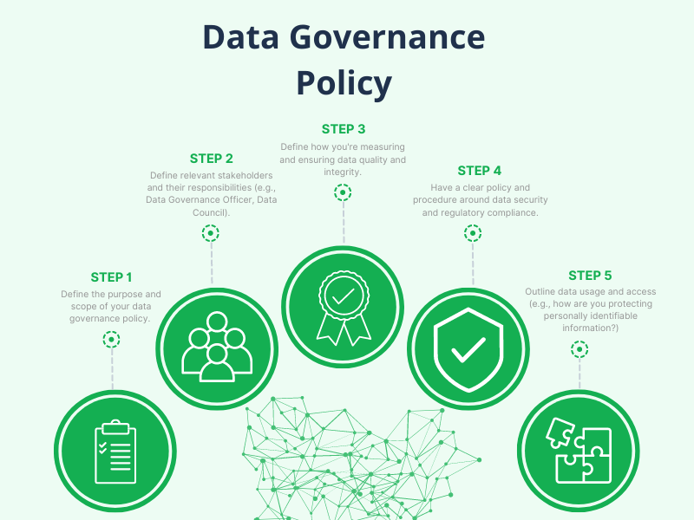

Slide 46
Importance of Data Governance Policies
Data governance policies are essential for ensuring data quality, security, accessibility, and retention.
They help organizations comply with legal and regulatory requirements related to data management.
They promote data sharing and collaboration across different departments and teams.
They help organizations make informed decisions based on accurate and reliable data.

Slide 47
Types of Data Governance Policies
Data quality policies
Data security policies
Data access policies
Data retention policies
Data classification policies

Slide 48
Data Quality Policies
Data quality policies aim to ensure that data is accurate, complete, and consistent.
Examples of data quality policies include:
Data validation rules
Data cleansing procedures
Data normalization standards

Slide 49
Data Security Policies
Data security policies aim to protect data from unauthorized access, corruption, or loss.
Examples of data security policies include:
Access controls
Encryption protocols
Authentication procedures

Slide 50
Data Access Policies
Data access policies aim to ensure that data is accessible to authorized users and groups.
Examples of data access policies include:
User authentication procedures
Authorization protocols
Role-based access controls

Slide 51
Data Retention Policies
Data retention policies aim to ensure that data is properly stored and retained according to organizational policies and legal requirements.
Examples of data retention policies include:
Data backup procedures
Data archiving protocols
Retention schedules

Slide 52
Data Governance Standards
Data governance standards are guidelines and frameworks that organizations follow to ensure the effective management of their data assets.
The purpose of data governance standards is to provide a consistent and repeatable approach to data management, ensuring data quality, security, accessibility, and retention.

Slide 53
Importance of Data Governance Standards
Data governance standards are essential for ensuring data quality, security, accessibility, and retention.
They help organizations comply with legal and regulatory requirements related to data management.
They promote data sharing and collaboration across different departments and teams.
They help organizations make informed decisions based on accurate and reliable data.

Slide 54
Types of Data Governance Standards
Industry-specific standards
These standards are developed for specific industries, such as healthcare, finance, and retail.
Generic standards
These standards can be applied to any industry and are developed by organizations such as ISO and ITU.
Framework standards
These standards provide a structured approach to data governance, such as the Data Governance Body of Knowledge (DGBOK) and the Information Governance Initiative (IGI).

Slide 55
Industry-Specific Data Governance Standards
Examples of industry-specific data governance standards include:
HIPAA (Health Insurance Portability and Accountability Act) for healthcare
GDPR (General Data Protection Regulation) for EU data protection
PCI-DSS (Payment Card Industry Data Security Standard) for payment card data
FISMA (Federal Information Security Management Act) for US federal government data

Slide 56
Generic Data Governance Standards
Examples of generic data governance standards include:
ISO/IEC 27001:2022
Information security, cybersecurity and privacy protection - Information security management systems
ITU-T
(International Telecommunication Union - Telecommunication standardization sector) recommendations
COBIT
(Control Objectives for Information and Related Technology) framework

Slide 57
Framework Data Governance Standards
Examples of framework data governance standards include:
Data Governance Body of Knowledge (DGBOK)
Information Governance Initiative (IGI)
Data Governance Framework (DGF)

Slide 58
Benefits of Implementing Data Governance Standards
Implementing data governance standards can help organizations:
Ensure data quality, security, accessibility, and retention
Comply with legal and regulatory requirements
Promote data sharing and collaboration
Make informed decisions based on accurate and reliable data
Reduce data-related risks and costs

Slide 59
Data Governance Procedures
Data governance procedures are the specific steps and processes that organizations follow to ensure the effective management of their data assets.
The purpose of data governance procedures is to provide a structured approach to data management, ensuring data quality, security, accessibility, and retention.

Slide 60
Importance of Data Governance Procedures
Data governance procedures are essential for ensuring data quality, security, accessibility, and retention.
They help organizations comply with legal and regulatory requirements related to data management.
They promote data sharing and collaboration across different departments and teams.
They help organizations make informed decisions based on accurate and reliable data.

Slide 61
Types of Data Governance Procedures
Data management procedures
Data security procedures
Data quality procedures
Data retention procedures

Slide 62
Data Management Procedures
Examples of data management procedures include:
Data creation: Ensuring that new data is created and captured accurately and completely.
Data modification: Ensuring that data is updated and modified accurately and completely.
Data deletion: Ensuring that data is deleted appropriately and securely.
Data archiving: Ensuring that data is transferred to long-term storage appropriately and securely.

Slide 63
Data Security Procedures
Examples of data security procedures include:
Encryption: Protecting data from unauthorized access by using encryption techniques.
Access controls: Restricting access to data based on user roles and permissions.
Authentication: Verifying the identity of users before granting access to data.
Authorization: Granting access to data based on user roles and permissions.

Slide 64
Data Quality Procedures
Examples of data quality procedures include:
Data validation: Checking data for accuracy and completeness.
Data cleansing: Identifying and correcting errors or inconsistencies in data.
Data normalization: Transforming data into a consistent format.

Slide 65
Data Retention Procedures
Examples of data retention procedures include:
Data backups: Creating copies of data to protect against data loss.
Data archiving: Transferring data to long-term storage.
Data disposal: Disposing of data securely and appropriately.

Slide 66
Key Data Governance Best Practices
Define data governance roles and responsibilities.
Establish data management policies and procedures.
Implement data security measures.
Monitor and audit data access and use.
Provide training and awareness programs.
Regularly review and update data governance policies and procedures.

Slide 67
Importance of Data Governance Implementation
Data governance implementation is essential for ensuring data quality, security, accessibility, and retention.
It helps organizations comply with legal and regulatory requirements related to data management.
It promotes data sharing and collaboration across different departments and teams.
It helps organizations make informed decisions based on accurate and reliable data.

Slide 68
Key Steps in Data Governance Implementation
Step 1: Define data governance roles and responsibilities.
Step 2: Establish data management policies and procedures.
Step 3: Implement data security measures.
Step 4: Monitor and audit data access and use.
Step 5: Provide training and awareness programs.
Step 6: Regularly review and update data governance policies and procedures.

Slide 69
Importance of Data Governance Metrics
Data governance metrics are essential for evaluating the effectiveness of data governance practices.
They help organizations identify areas for improvement and measure progress over time.
They provide a common language and framework for communication about data governance across different departments and teams.

Slide 70
Key Data Governance Metrics
Metric 1: Data Quality Index (DQI) - measures the accuracy, completeness, and consistency of data.
Metric 2: Data Security Index (DSI) - measures the effectiveness of data security measures.
Metric 3: Data Accessibility Index (DAI) - measures the ease of access to data for authorized users.
Metric 4: Data Retention Index (DRI) - measures the effectiveness of data retention policies and procedures.
Metric 5: Data Governance Maturity Index (DGMI) - measures the overall maturity of data governance practices.

Slide 71
Data Quality Index (DQI)
The Data Quality Index (DQI) measures the accuracy, completeness, and consistency of data.
Calculation: DQI = (Accuracy + Completeness + Consistency) / 3
Example: A DQI score of 0.8 indicates that data is 80% accurate, complete, and consistent.

Slide 72
Data Security Index (DSI)
The Data Security Index (DSI) measures the effectiveness of data security measures.
Calculation: DSI = (Data Encryption + Access Controls + Incident Response) / 3
Example: A DSI score of 0.9 indicates that data security measures are 90% effective.

Slide 73
Importance of Data Governance Monitoring and Reporting
Data governance monitoring and reporting are essential for ensuring data quality, security, accessibility, and retention.
They help organizations comply with legal and regulatory requirements related to data management.
They promote data sharing and collaboration across different departments and teams.
They help organizations make informed decisions based on accurate and reliable data.

Slide 74
Key Data Governance Monitoring and Reporting Tools
Tool 1: Data Governance Dashboards - provide real-time visibility into data quality, security, accessibility, and retention.
Tool 2: Data Quality Reports - measure data accuracy, completeness, and consistency.
Tool 3: Data Security Reports - measure data security controls and incident response.
Tool 4: Data Accessibility Reports - measure data availability and usability.
Tool 5: Data Retention Reports - measure data retention and disposal practices.

Slide 75
Data Governance Dashboards
Data governance dashboards are interactive tools that provide real-time visibility into data quality, security, accessibility, and retention.
Features:
Data quality metrics (e.g., accuracy, completeness, consistency)
Data security metrics (e.g., encryption, access controls, incident response)
Data accessibility metrics (e.g., data availability, usability)
Data retention metrics (e.g., data retention schedules, disposal practices)
Benefits:
Real-time visibility into data governance practices
Easy-to-understand metrics and reports
Identification of areas for improvement

Slide 76
Data Quality Reports
Data quality reports measure data accuracy, completeness, and consistency.
Metrics:
Data accuracy (e.g., percentage of accurate data)
Data completeness (e.g., percentage of complete data)
Data consistency (e.g., percentage of consistent data)
Benefits:
Identification of data quality issues
Tracking of data quality over time
Improvement of data quality practices

Slide 77
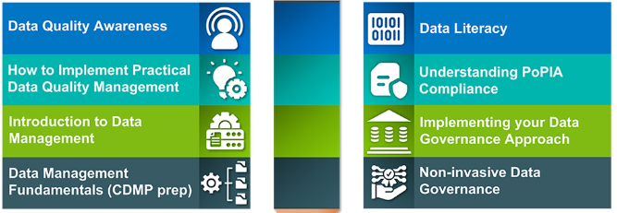
Importance of Data Governance Training and Awareness
Data governance training and awareness are essential for ensuring effective data management practices.
They help employees understand data governance policies, procedures, and best practices.
They promote major data governance goals such as data quality, security, accessibility, and retention.

Slide 78
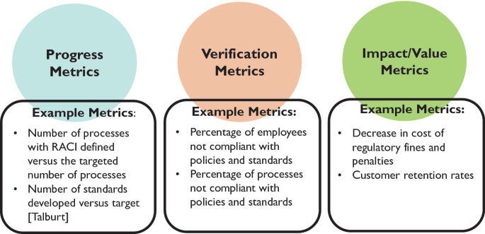
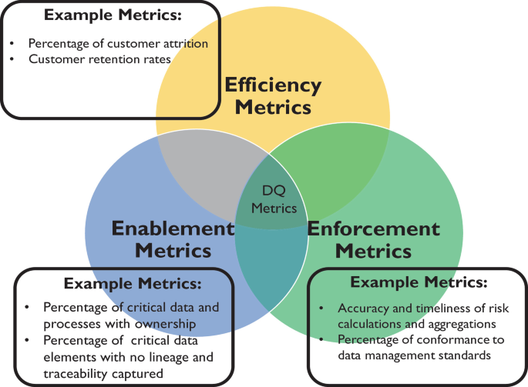
Data Governance Metrics and Performance Indicators
Metrics and performance indicators are used to measure the effectiveness of data governance practices.

Slide 79
Data Governance Risk Management
Data governance risk management involves identifying, assessing, and mitigating risks associated with data management.
The purpose of data governance risk management is to ensure that data is accurate, complete, and protected from unauthorized access or misuse.

Slide 80
Importance of Data Governance Risk Management
Data governance risk management is essential for ensuring the integrity and security of data.
It helps organizations comply with legal and regulatory requirements related to data management.
It promotes data sharing and collaboration across different departments and teams.
It helps organizations make informed decisions based on accurate and reliable data.

Slide 81
Key Data Governance Risk Management Strategies
Strategy 1: Data Classification
Strategy 2: Access Control
Strategy 3: Data Encryption
Strategy 4: Data Backup and Recovery
Strategy 5: Data Quality Control

Slide 82
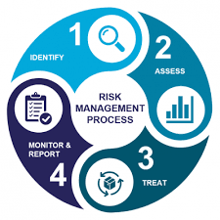
Data Governance Risk Management Framework
Framework:
Identify risks
Assess risks
Mitigate risks
Monitor risks
Risk management process:
Risk identification
Risk assessment
Risk mitigation
Risk monitoring

Slide 83
Data Governance Risk Identification
Identifying risks involves analyzing data management practices and identifying potential risks.
Risks can include data breaches, data corruption, data loss, and non-compliance with regulations.
Techniques for identifying risks include risk assessments, security audits, and compliance audits.

Slide 84
Data Governance Risk Assessment
Risk assessment involves evaluating the likelihood and impact of identified risks.
The likelihood of a risk occurring is determined by analyzing factors such as the probability of a security breach or data corruption.
The impact of a risk occurring is determined by analyzing factors such as the potential financial loss or reputational damage.
Risk assessment tools include risk matrices and risk heat maps.

Slide 85
Data Governance Risk Mitigation
Risk mitigation involves implementing measures to reduce the likelihood or impact of identified risks.
Measures can include implementing security controls, enforcing data access controls, and creating data backup and recovery plans.
Risk mitigation strategies should be tailored to the specific risk and the organization's needs.

Slide 86
Data Governance Risk Monitoring
Risk monitoring involves regularly reviewing and updating risk assessments and risk mitigation measures.
Monitoring helps ensure that risk mitigation measures are effective and that new risks are identified and addressed.
Risk monitoring tools include risk management software and dashboards.

Slide 87
Key Data Governance Future Trends
Trend 1: Artificial Intelligence and Machine Learning
Trend 2: Cloud Computing
Trend 3: Blockchain
Trend 4: Internet of Things (IoT)
Trend 5: Data Privacy and Ethics

Slide 88
Preparing for Data Governance Future Trends
Organizations should stay informed and proactive in adopting new technologies and practices.
Develop a data governance strategy that accommodates emerging trends.
Invest in employee training and upskilling to address future data management challenges.
Foster a culture of data-driven decision-making and ethical data management.

Slide 89
Summary of Key Takeaways
Data governance is a critical aspect of data management.
Data governance roles and responsibilities are essential for ensuring data quality, security, accessibility, and retention.
Data governance roles include data owners, data custodians, data users, and data stewards.
Data governance responsibilities include data management, data security, data quality, data accessibility, and data retention.
Effective data governance requires clear roles and responsibilities, data governance policies and procedures, and regular monitoring and reporting.

Slide 90
Final Thoughts and Call to Action
Data governance is a continuous process that requires ongoing efforts and commitment.
Implementing data governance can seem daunting, but it's essential for ensuring data integrity, security, and compliance.
Start by identifying your organization's data governance needs and developing a data governance strategy.
Assign clear roles and responsibilities, develop policies and procedures, and establish regular monitoring and reporting processes.
Don't wait – start implementing data governance today to ensure your organization's data is accurate, secure, and compliant.

